Slide 1
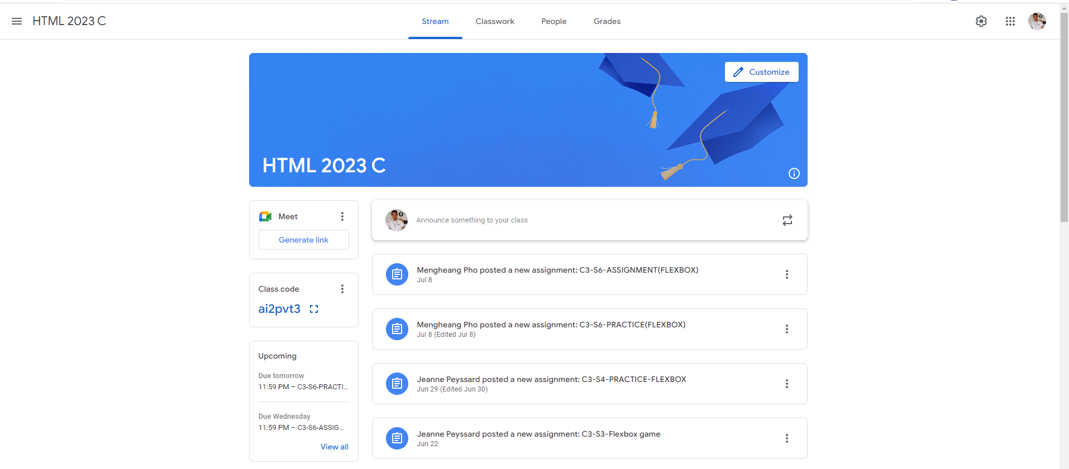
Identify root components of website below

Slide 2
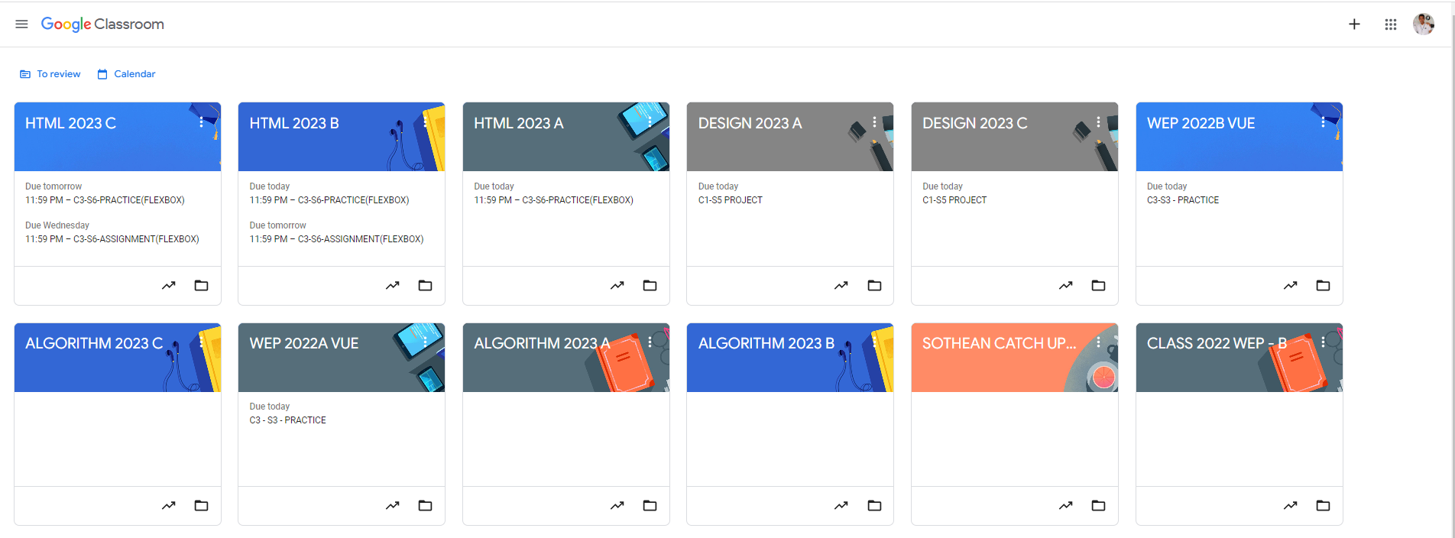
Root div
- Height: 100vh
content
nav
Flex: 0
header
Flex: 0
Flex: 1

Slide 3
Explanation:
div: header
div: content
First, we have to divide the page into two divs. These two will become the parents of smaller divs and provide the layout to them.

Slide 4
In div: header
div: title
div: menu
div: user
We need to further divide the header into smaller divs in order to arrange them the way we desire. The divs above will have to divide into smaller divs if needed.

Slide 5
In div: content
padding
padding
div: classroom
padding
padding
div: classwork
div: meetings
div: assignments
In this div, we can see that the contents are aligned at the center, and padding was used to make the white spaces for the design. We divided this div into two smaller divs, classroom and classwork. Classwork was also divided into two more divs, meetings and assignments, for a more easy user experience.

